Slide 1


HER HEALTH ADVOCATE
Aditi, Arushi, Krit, Sharika

Slide 2
Unmet
Need
Gender-specific and distinct services
Need to recognize social context for women’s lives
High responsibility and lower incomes increase health risk

Slide 3
There’s a pain gap, but there’s also a credibility gap. Women are not believed about their bodies — period.
— Anushay Hossain, author of "The Pain Gap," Washington, D.C.

Slide 4
200
100
0
The AHA said that women with chest pains wait 29% longer in the ER to be seen for potential heart attacks.
Women with acute abdominal pain are up to 25% less likely to be treated with opioid painkillers.
Compared to men with the similar symptoms of heart disease, women were 200% more likely to be diagnosed with a mental disorder instead?
Washington Post, 2022

Slide 5
Existing Solutions
WHO
General patient advocates

Slide 6
Empathy Map
WHO are we empathizing with?
What do they do?
What do they SEE?
What do they need/want to do?
What do they THINK and FEEL?
What do
they HEAR?
What do they SAY?
Notes:
WHO are we empathizing with?
What do they do?
What do they need/want to do?
What do they SEE?
What do they HEAR?
What do they SAY?

Slide 7
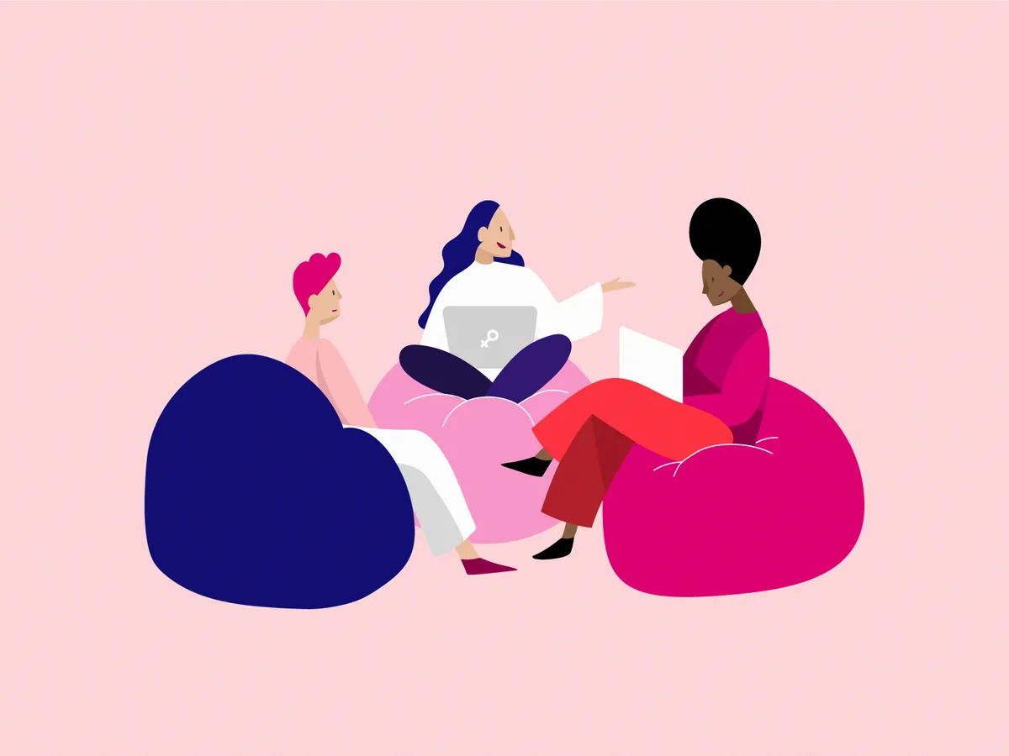
Our Solution
Our web application helps women who want health advocacy by reducing gender bias and denial of pain relief for them, and enabling improved wellbeing through interactive domains

Slide 8
SWOT Analysis
STRENGTHS
Access to women
Improved health
Easy access (24/7)
Innovative
Minimize bias
WEAKNESSES
People prefer human interaction
Wireframe was difficult to translate
S
W
Mobile app
Train chatbot more
Expand diary page
OPPORTUNITIES
Security
THREATS
O
T

Slide 9
How We Approached Our Project
Brainstorm ideas
Wireframe and tech stack
Pitch!
1
3
5
2
4
6
Delegate tasks and set timeline
Front & back-end
Preparing presentation
Relax :)

Slide 10
Tech Stack
HTML/CSS/JS
Python Flask
JWT Authentication
MongoDB
ChatGPT API

Slide 11
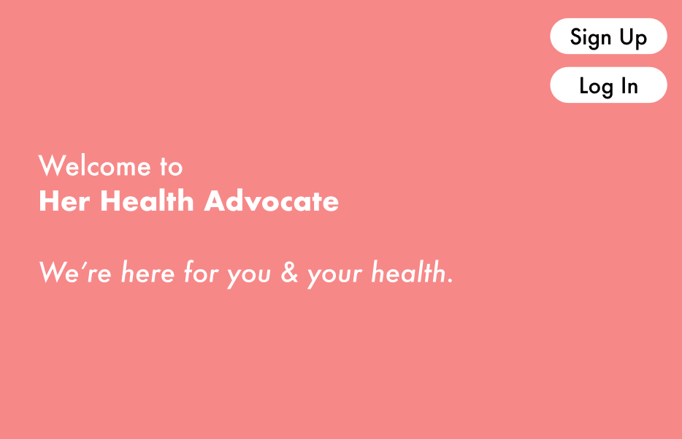

Slide 12
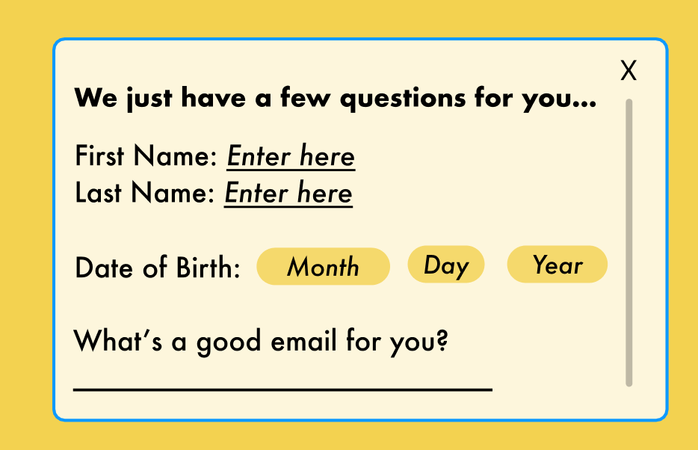

Slide 13
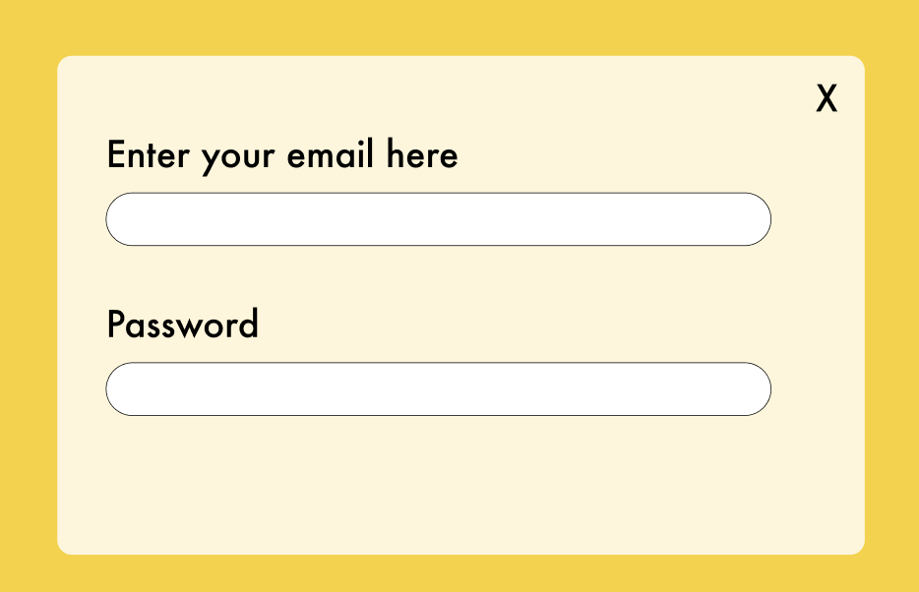

Slide 14
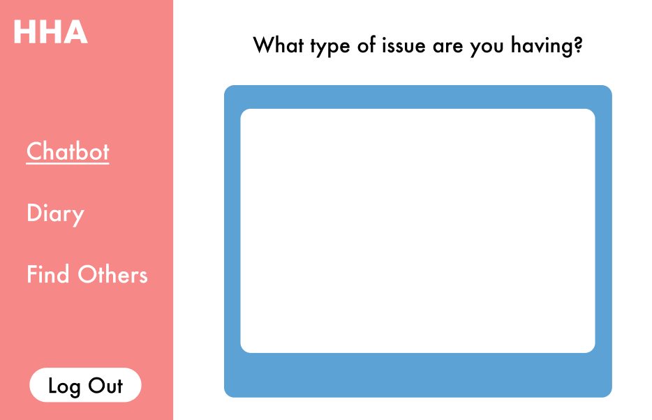

Slide 15
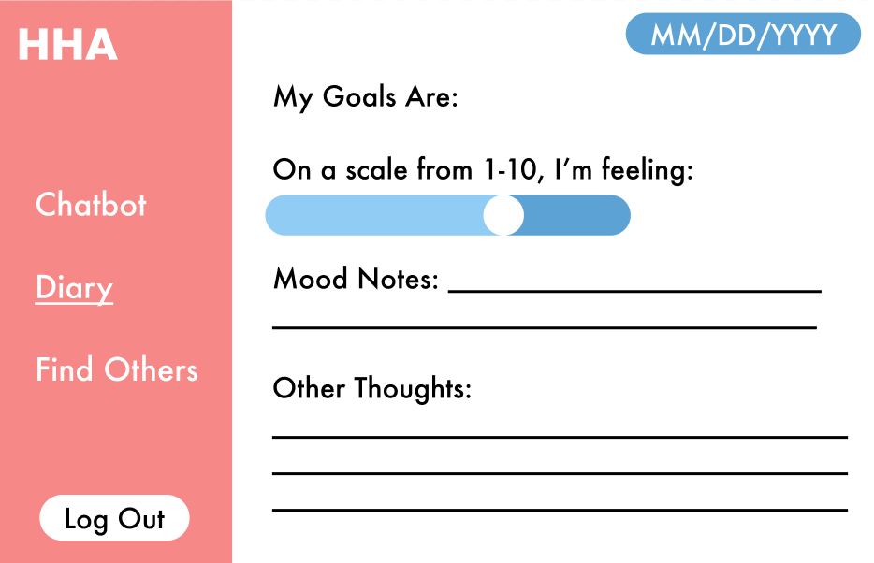

Slide 16
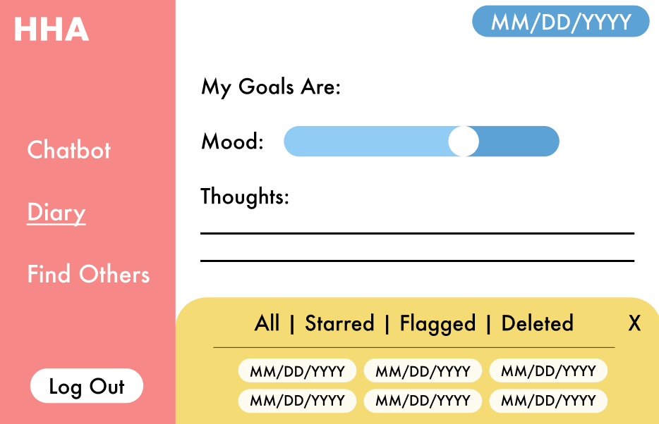

Slide 17
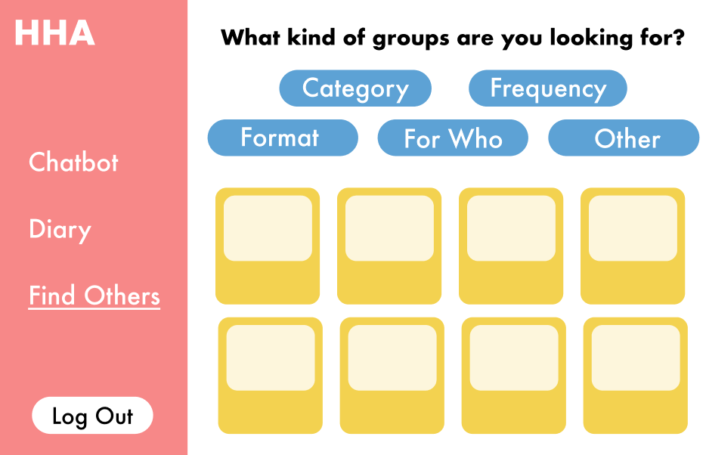

Slide 18
Conclusions
& Future Directions
Our application aids in increasing awareness in women regarding their health for better productivity
Customer and Market potential discovery

Slide 19
Thank You!
Any questions?

Slide 20
Credits
Special thanks to all the people who made and released these awesome resources for free:
Presentation template by SlidesCarnival
Photographs by Unsplash
And to the staff and sponsors of SheInnovates 2023!

Slide 21

Free templates for all your presentation needs
For PowerPoint and Google Slides
100% free for personal or commercial use
Ready to use, professional and customizable
Blow your audience away with attractive visuals

